Slide 1
Predicting heart failure using public-access data
Using R and JAGS

Slide 2
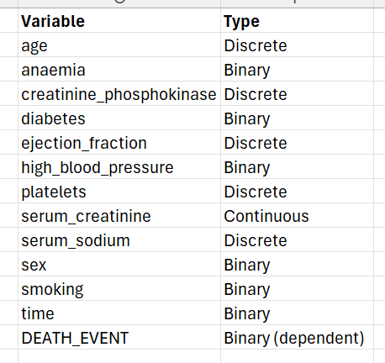
https://www.kaggle.com/datasets/andrewmvd/heart-failure-clinical-data

Slide 3
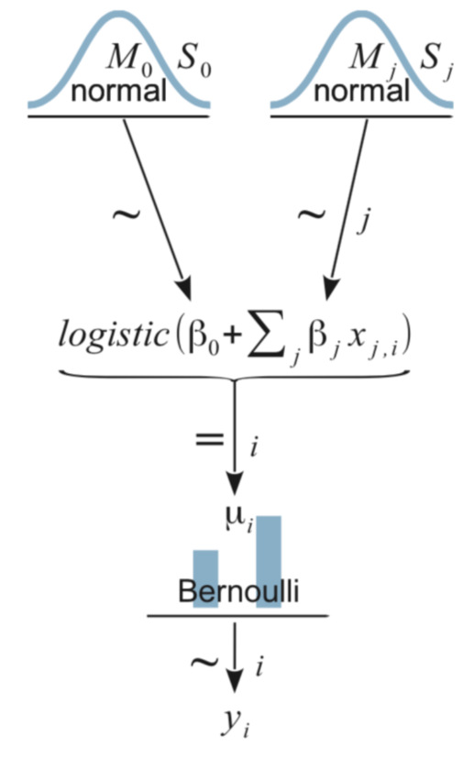
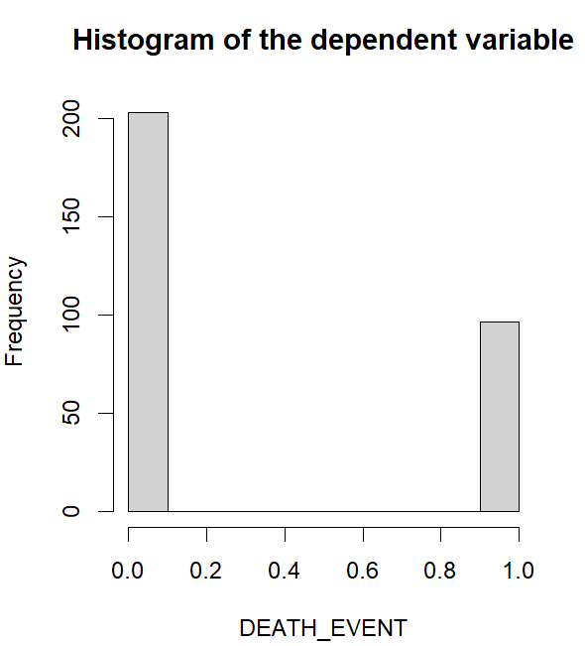

Slide 4
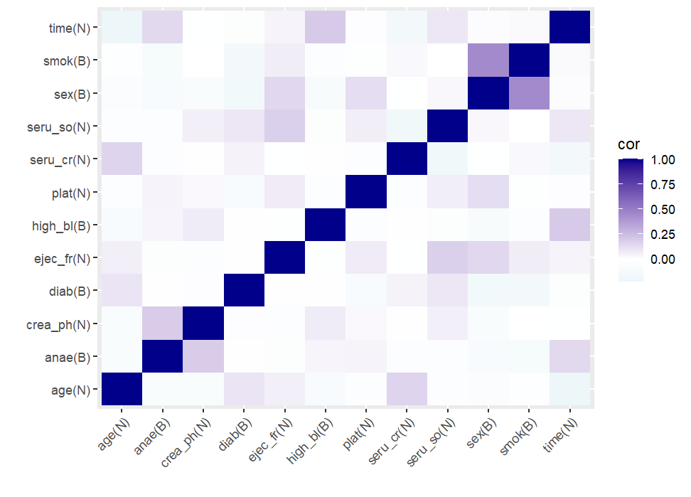

Slide 5
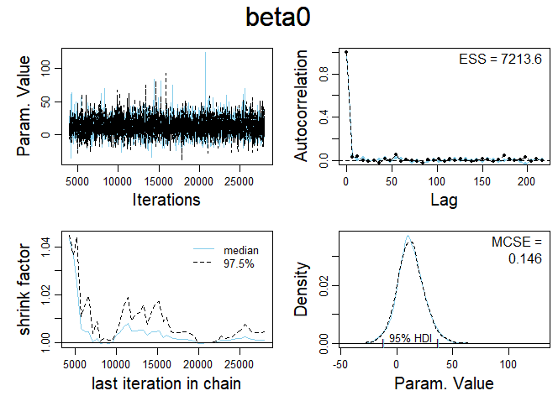
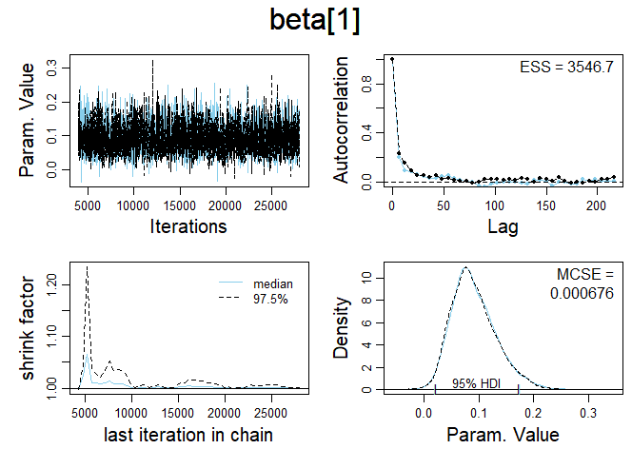
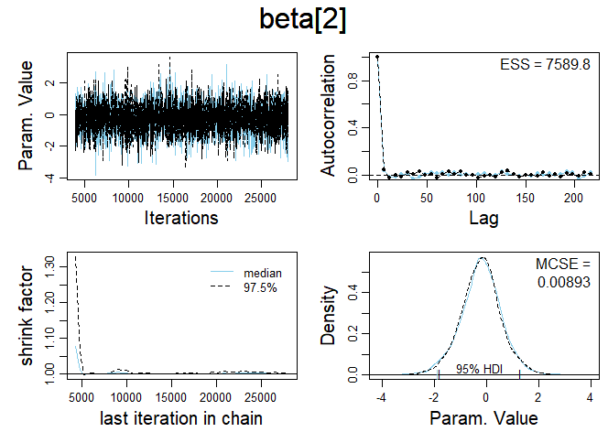
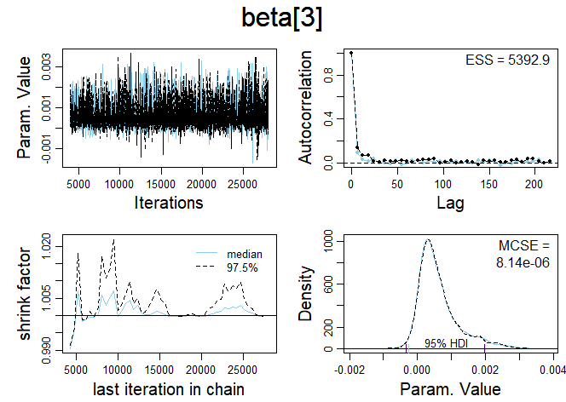

Slide 6
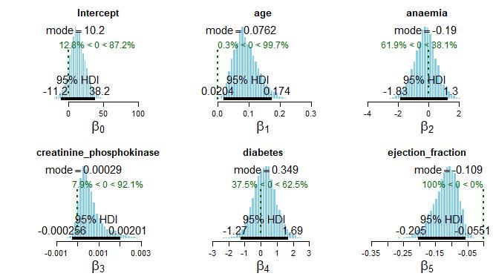
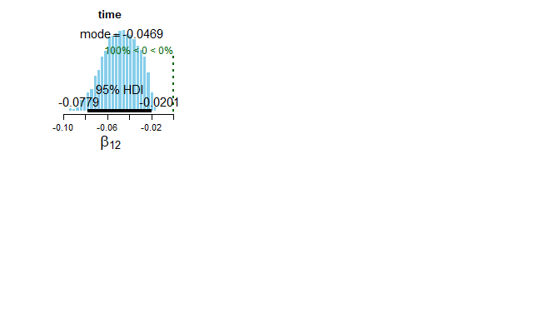
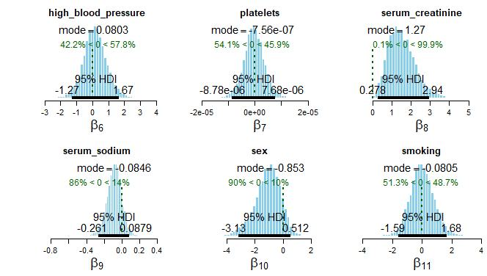

Slide 7
Summary
Results:
No significant correlation between independent variables
MCMC process obtained satisfactory results, according to diagnostics
Running a model with all variables revealed some parameters are very close to 0
To do:
Include predictions in the models (in model selection)
Run several models for model selection using the parameters that are not very close to 0
Use Bayes Factor and Sensitivity Analysis to determine best final model

